Slide 1

Compiler Design Lab
Suman Mia
Lecturer
Dept. Of CSE
Dhaka International University

Slide 2
Lex File Format
Definitions
%%
Rules
%%
Supplementary Code
%{
#include<stdio.h>
#include<string.h>
int i = 0;
%}
/* Rules Section*/
%%
([a-zA-Z0-9])* {i++;}
/* Rule for counting
number of words*/
"\n" {printf("%d\n", i); i = 0;}
%%
int yywrap(void){
}
int main()
{
// The function that starts the analysis
yylex();
return 0;
}

Slide 3
Lex program check whether the given number is odd or even
Program:
%{
#include <stdio.h>
%}
%%
[0-9]+ {
int num = atoi(yytext);
if (num % 2 == 0) {
printf("%d is even\n", num);
} else {
printf("%d is odd\n", num);
}
}
. {
// Ignore unrecognized characters
}
%%
int main()
{
yylex();
return 0;
}
int yywrap()
{
return 1;
}

Slide 4
Describe:
The [0-9]+ pattern matches one or more digits.
Inside the rule for [0-9]+, we convert the matched number (yytext) to an integer using atoi(yytext).
We then check if the number is divisible by 2 using the modulo operator %. If the remainder is 0, the number is even; otherwise, it is odd.
The appropriate message is printed based on whether the number is even or odd.
The dot (.) rule ignores any unrecognized characters.
In the main() function, yylex() is called to start the lexer.
The yywrap() function is implemented to indicate the end of input.

Slide 5
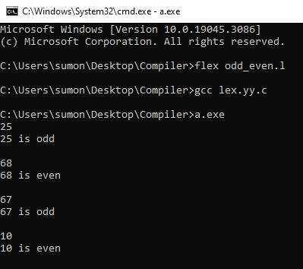
Output

Slide 6
Lex program to recognize simple arithmetic expressions
Program:
%{
#include <stdio.h>
%}
%%
[0-9]+(\.[0-9]+)? {
printf("Number: %s\n", yytext);
}
[+\-*/] {
printf("Operator: %s\n", yytext);
}
[()] {
printf("Parenthesis: %s\n", yytext);
}
. {
// Ignore other characters
}
%%
int main()
{
yylex();
return 0;
}
int yywrap()
{
return 1;
}

Slide 7
Describe:
[0-9]+(\.[0-9]+)?:
This rule matches numbers in the input text.
[0-9]+ matches one or more digits.
(\.[0-9]+)? matches an optional decimal point followed by one or more digits.
[+\-*/]:
This rule matches arithmetic operators (+, -, *, /) in the input text.
[()]:
This rule matches parentheses '(' and ')' in the input text.

Slide 8
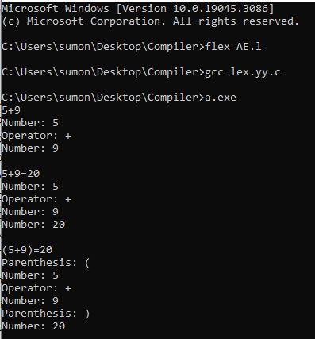
Output

Slide 9
Lex program to identify Keywords and Identifiers
%{
#include<stdio.h>
int others = 0;
int keyword = 0;
int id = 0;
%}
/*Rules Section*/
%%
"int"|"double"|"float"|"char"|"do"|"while"|"main"|"return"|"printf"|"scanf"|"include"|"stdio.h" {
keyword++;
printf("\'%s\' is a keyword\n",yytext);}
[a-zA-Z­_][a-zA-Z0-9_]* {
id++;
printf("\'%s\' is an identifier\n",yytext);
}
. {others++;}
%%
int main()
{
yyin = fopen("input.c","r");
yylex();
printf("Number of identifier is %d\n", id);
return 0;
}
int yywrap()
{
return 1;
}

Slide 10
Describe:
%{ and %}: These symbols indicate the beginning and end of the "C" code section. In this case, the code includes the <stdio.h> header file and declares three variables: others, keyword, and id.
The %% symbol separates the Lex rules section from the C code section.
"int"|"double"|"float"|"char"|"do"|"while"|"main"|"return"|"printf"|"scanf"|"include"|"stdio.h": This rule matches any of the listed keywords. When a match is found, the associated action increments the keyword count and prints the keyword using printf.
[a-zA-Z_][a-zA-Z0-9_]*: This rule matches identifiers, which consist of a letter or underscore followed by zero or more letters, digits, or underscores. When a match is found, the associated action increments the id count and prints the identifier using printf.

Slide 11
Describe:
“.” : This rule matches any character that doesn't match the previous rules. It represents all other characters in the input text. When a match is found, the associated action increments the others count.
int main(): This is the entry point of the program. It opens the "input.c" file for reading using fopen, then calls yylex() to start the lexical analysis process based on the defined Lex rules. After the analysis is complete, it prints the number of identifiers (id) found using printf.
int yywrap(): This function is called by the Lex-generated scanner when it reaches the end of input. It serves as the termination condition for the scanning process and returns 1 to indicate the end of input.

Slide 12
Input. C File
#include<stdio.h>
//this is a comment
int main()
{
int number = 10;
double value = 1.67;
printf("The number is: %d\n", number);
return 0;
}
/*
this is a multi line comment
*/

Slide 13
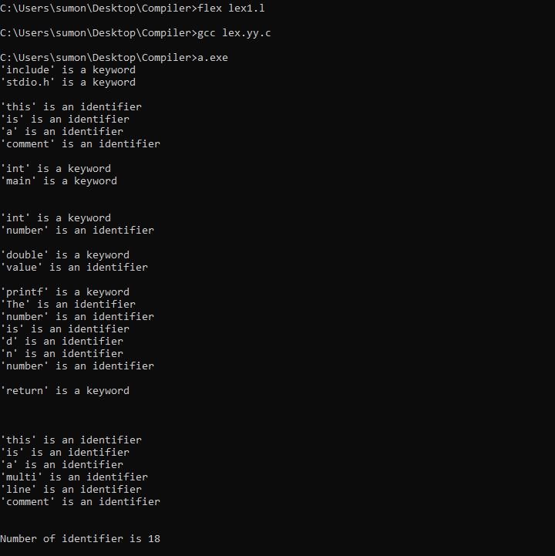
Output

Slide 14


